Slide 1
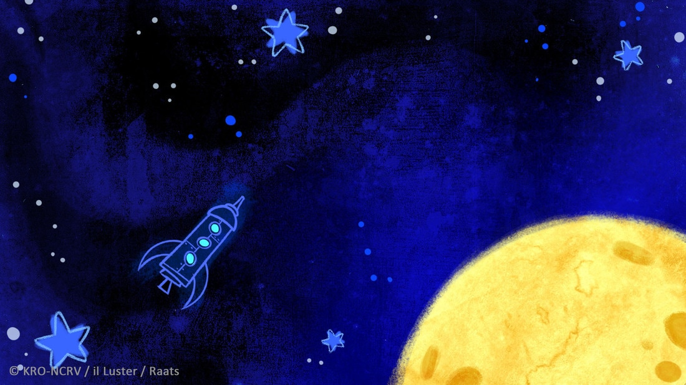
Playground
Concept Art / Mood Boards Process
Willa Liberi

Slide 2
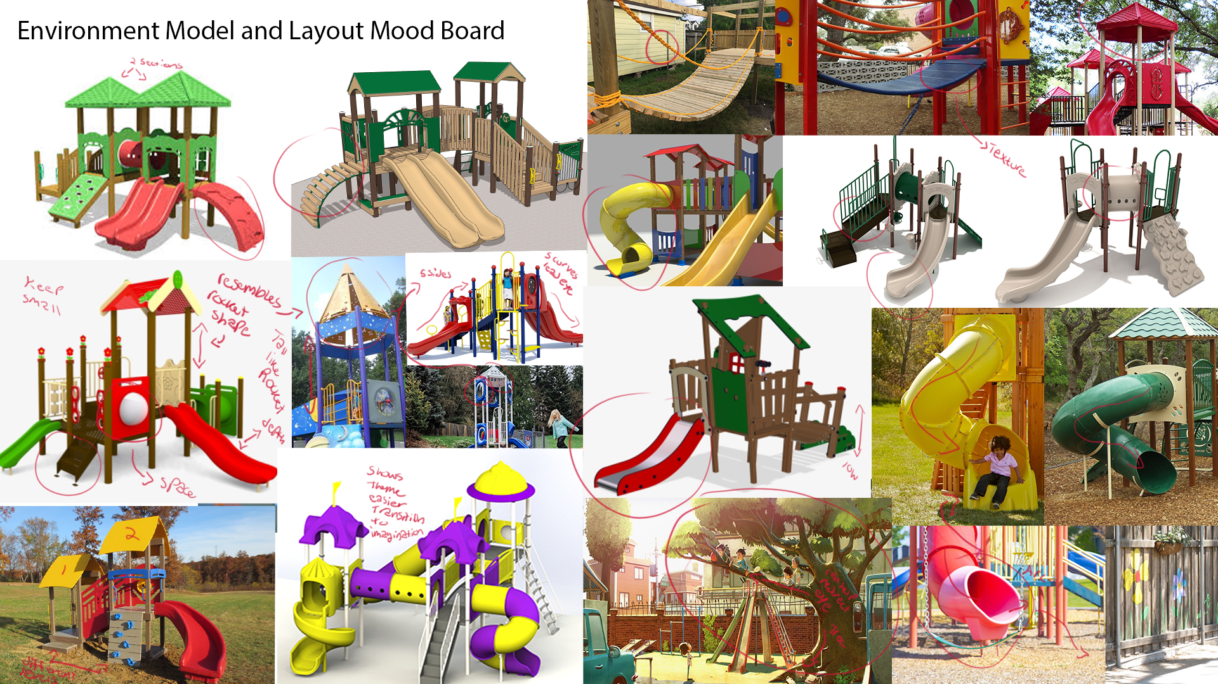
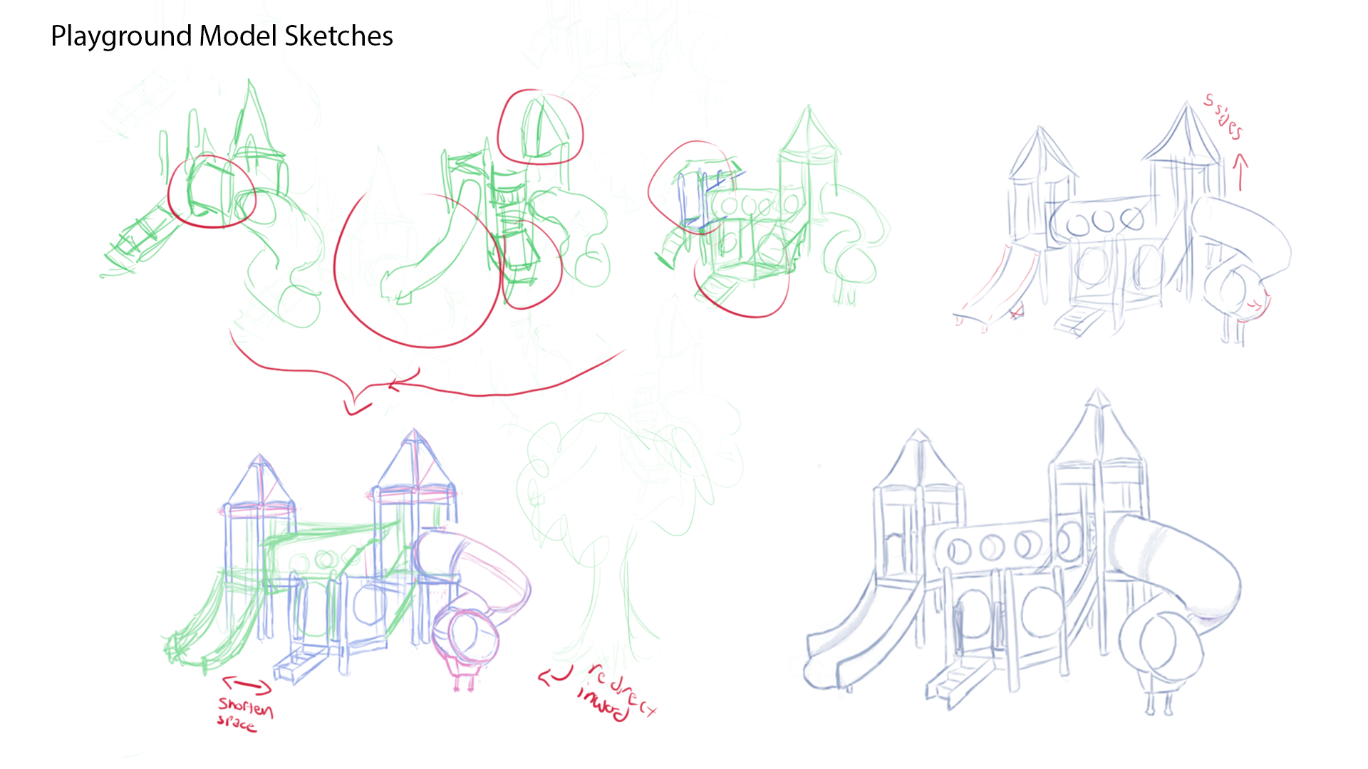
Models and Layout
Lower to the ground – young kids
Arcs lead eye to character
Layout keep 1/3 rule
Clear silhouette for acting space
Remember the viewer reads left to right
Little hints that inspire her imagination of space
EX taller tower , clear circle windows inspires space ship, Shape engraved into playground, colors
Models and Layout
Sketched 3 ideas out and merged the parts I liked to create one
Consider adding a tree to lead the eye back inward to the character, add interest in height, and help fill the space that does not need another character to occupy it

Slide 3
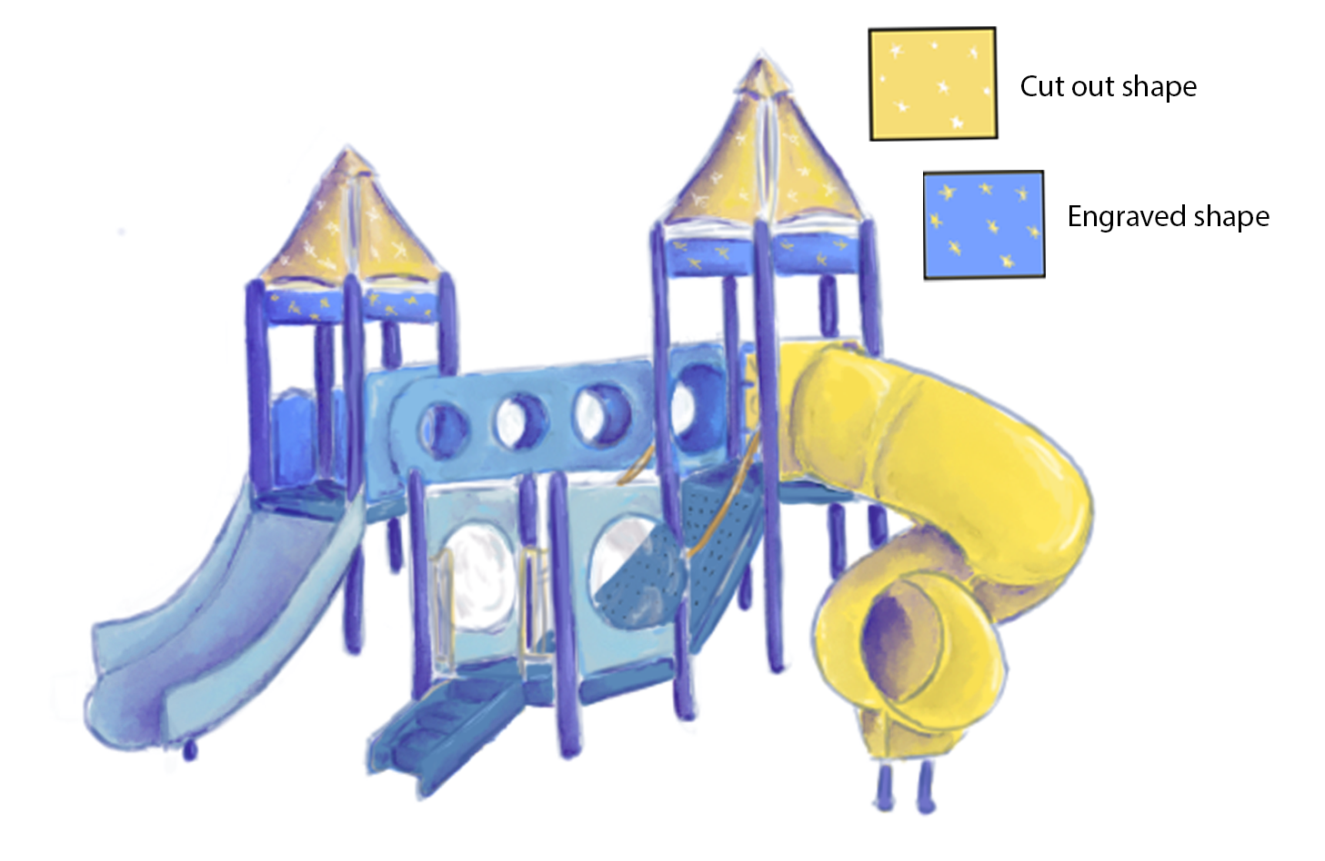
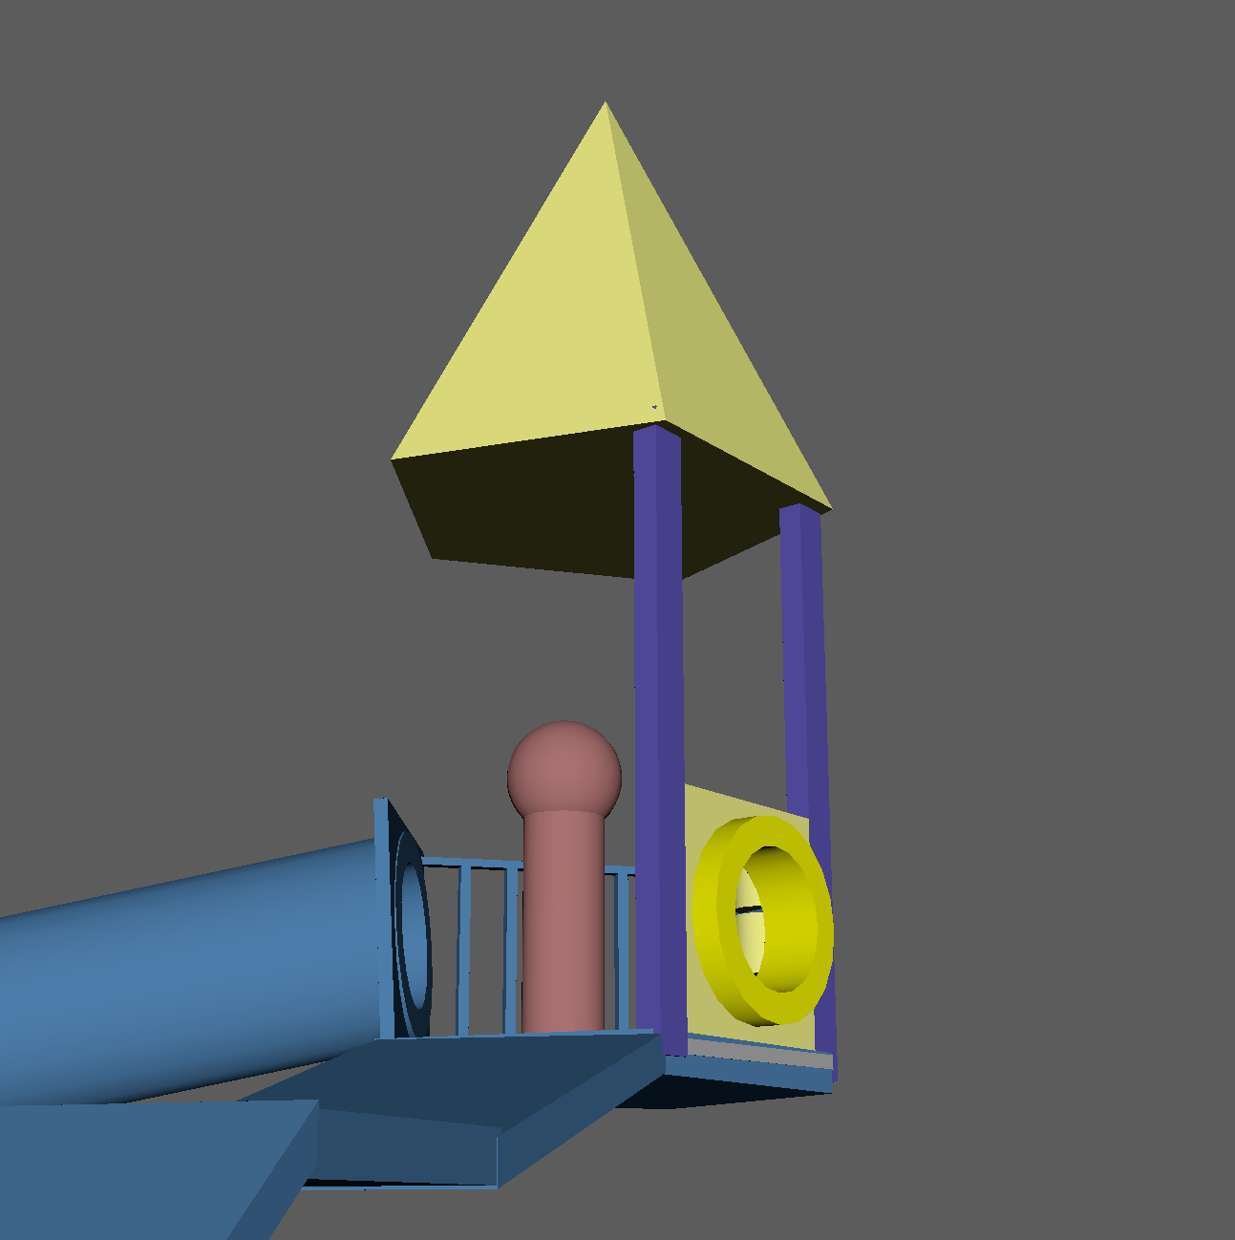
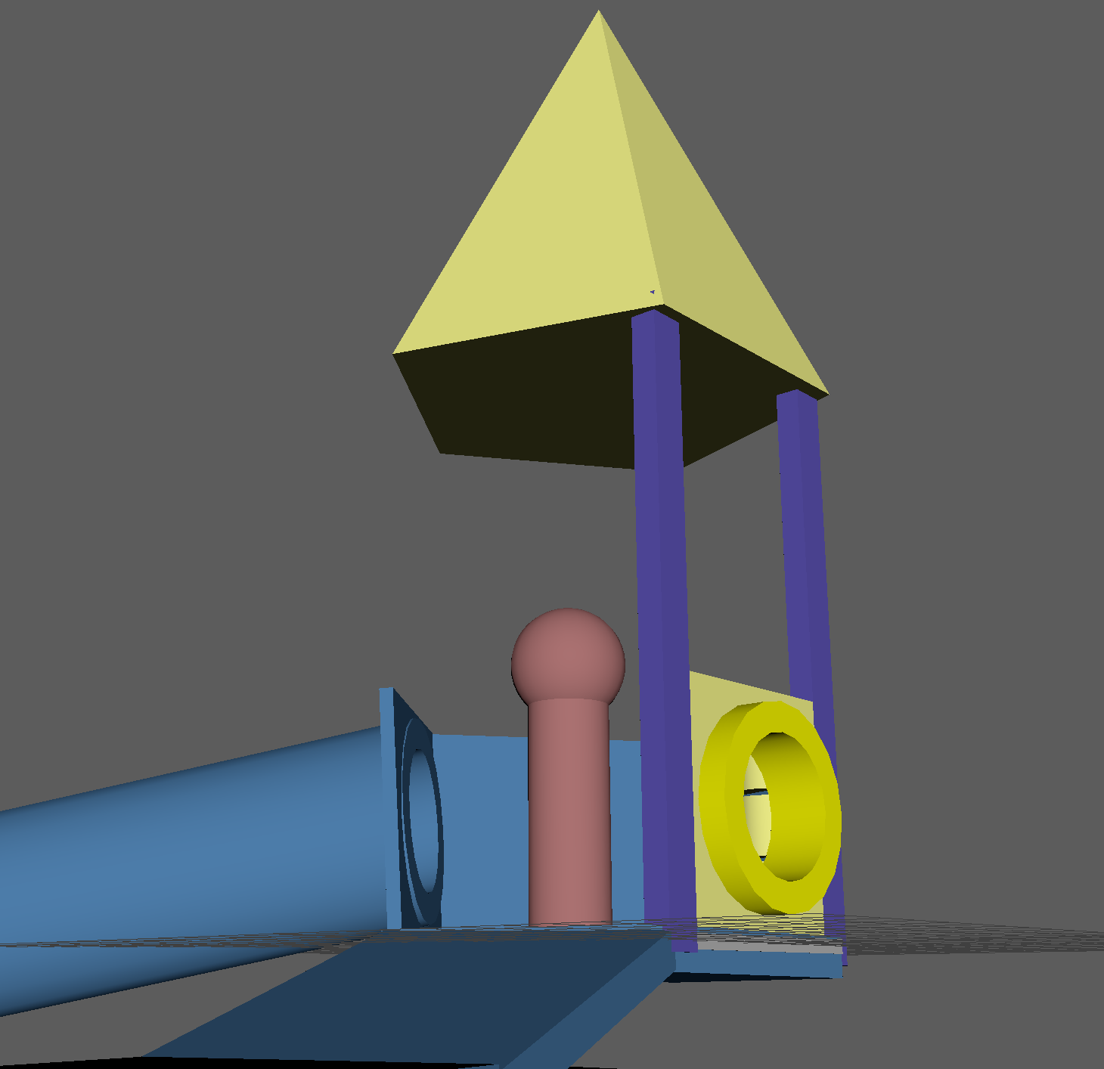
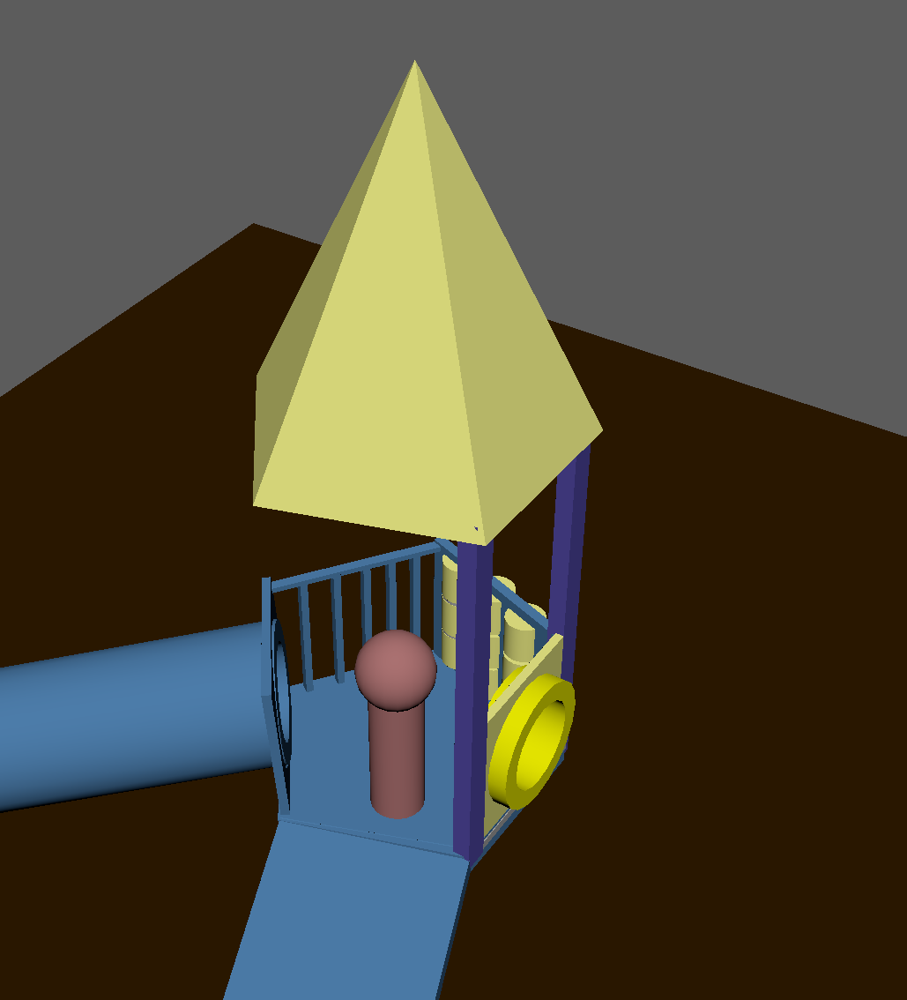
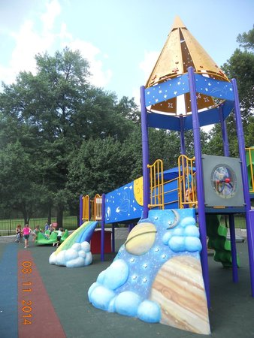
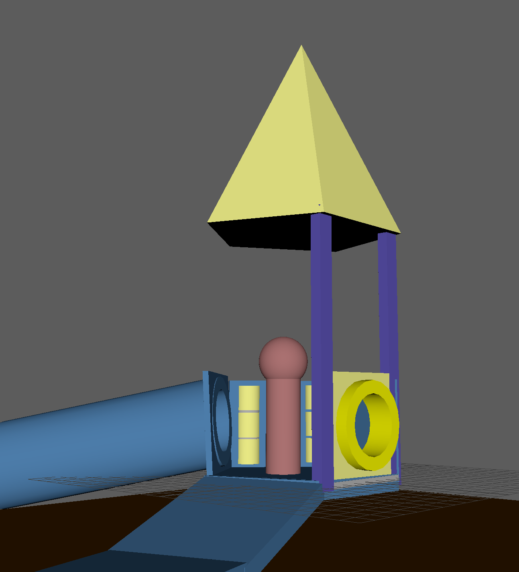
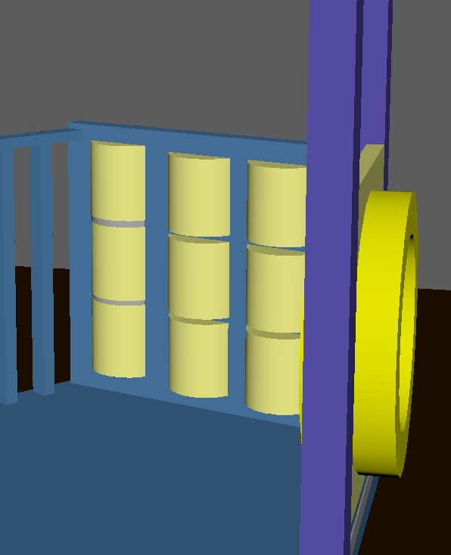
Keep character easy to see silhouette / acting choices
Options
Bars closest to tube - XO game closest to slide
Plane (with engravings maybe) closest to tube - XO game closest to slide
XO game closest to Tube – Plane by slide (with engravings maybe)
Model Shape
5 sides to have a little nod to where her imagination will go (maybe it helped inspire it) – Like a rocket
XO game
can peal of into space shapes when in imagination
Adds interest and relatability to playground

Slide 4
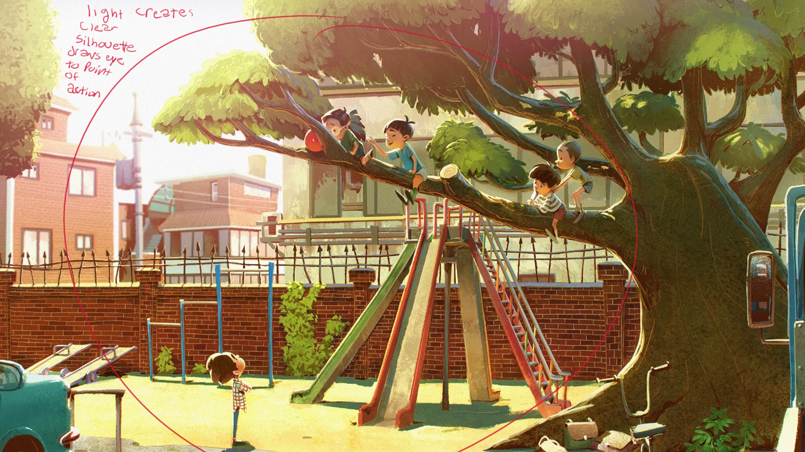
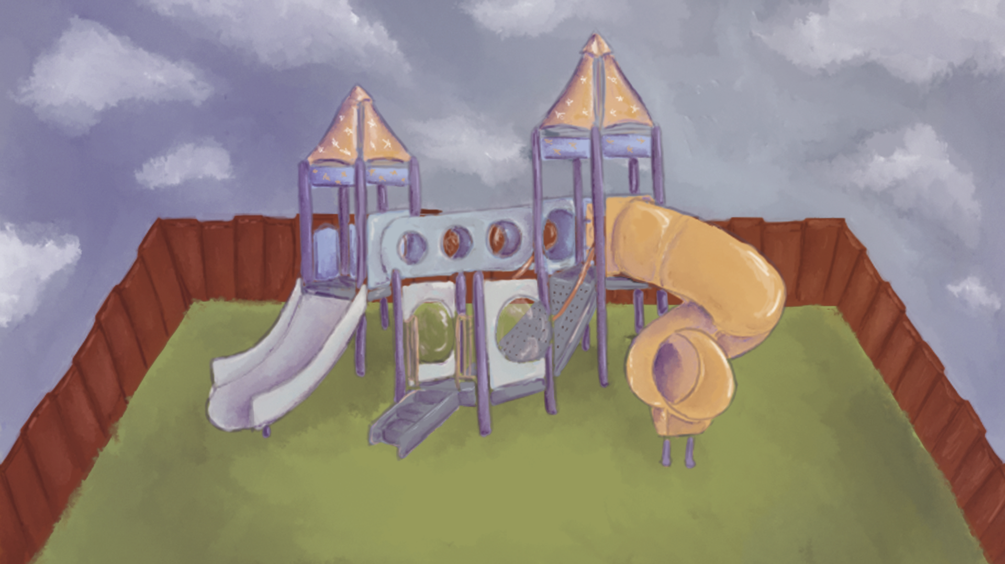
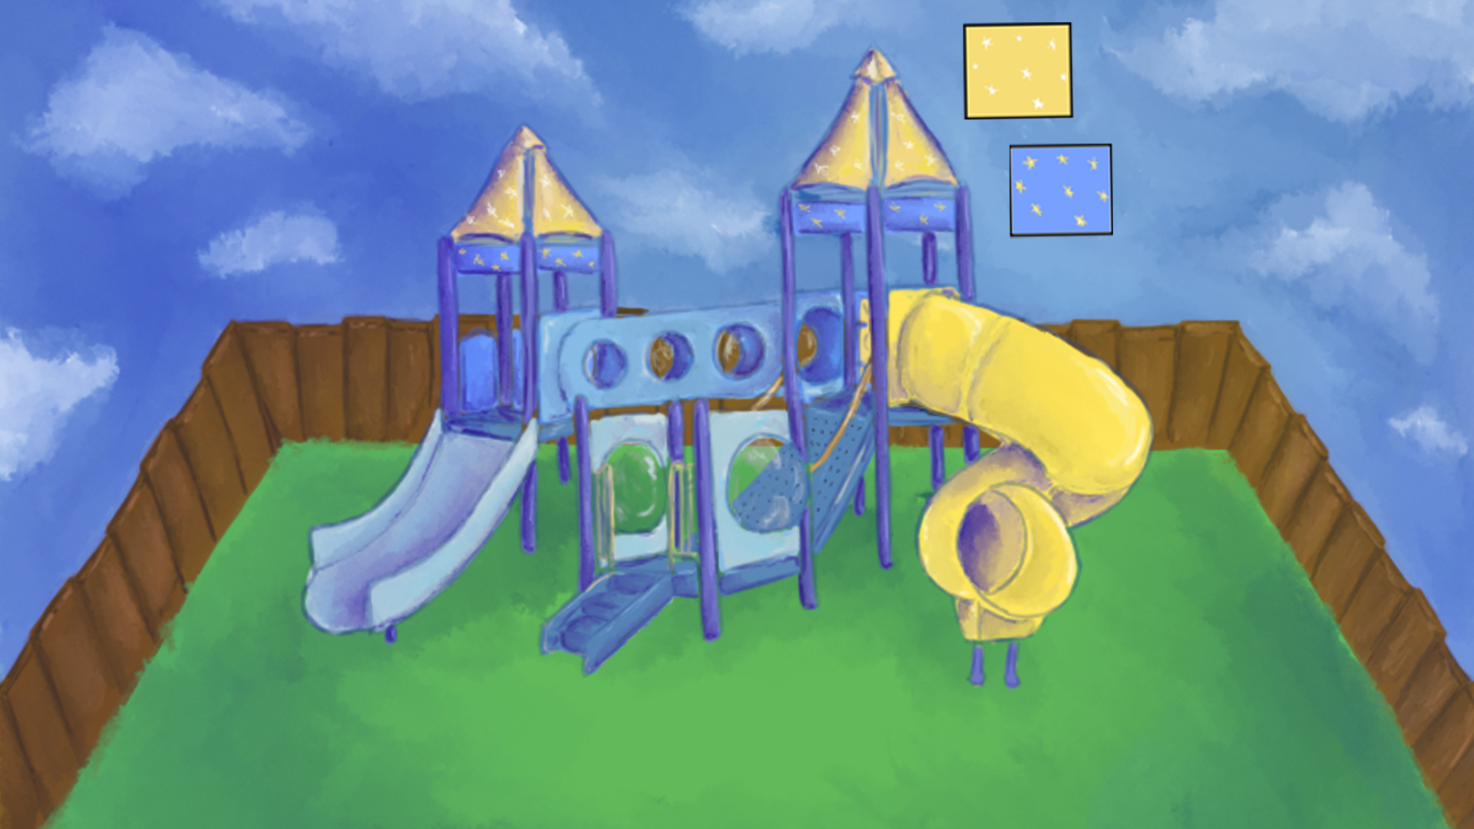
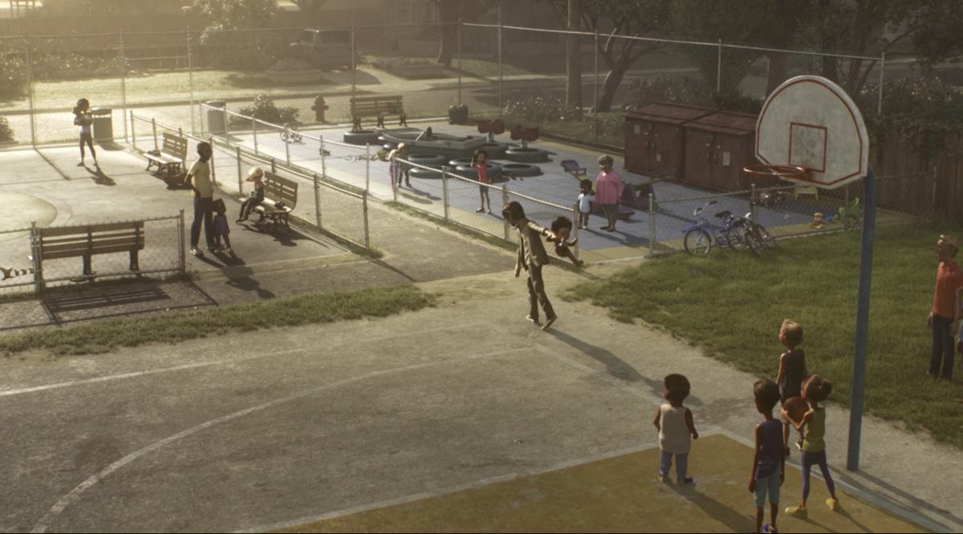
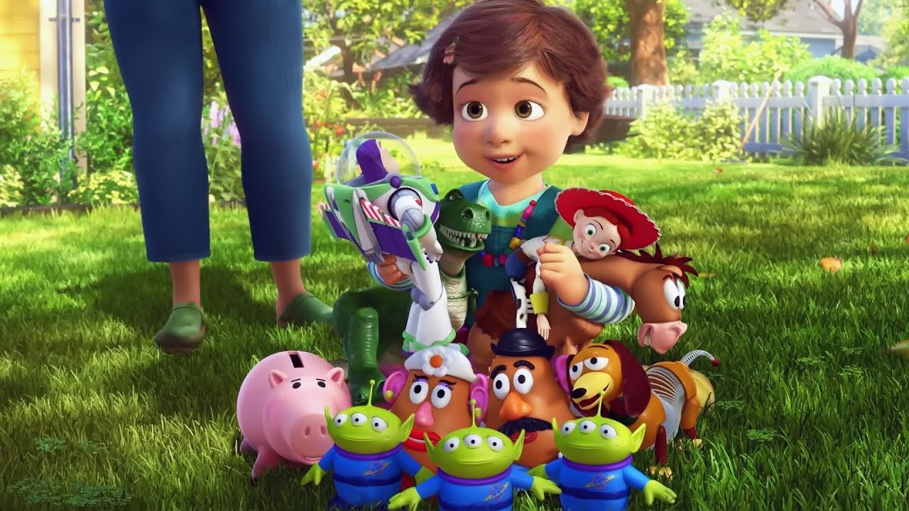
Progression
Starts with Muted colors – ends more vibrant
Notes
Make the yellow slides Hight much higher than the blue in comparison – more intimidating as a kid
Consider
A tree to draw eye back to character
EX at the end when she tumbles out of the slide
this can help place her on 1/3 rule and help add interest with the slide without needing more children and not pulling your eye from the yellow slide)

Slide 5
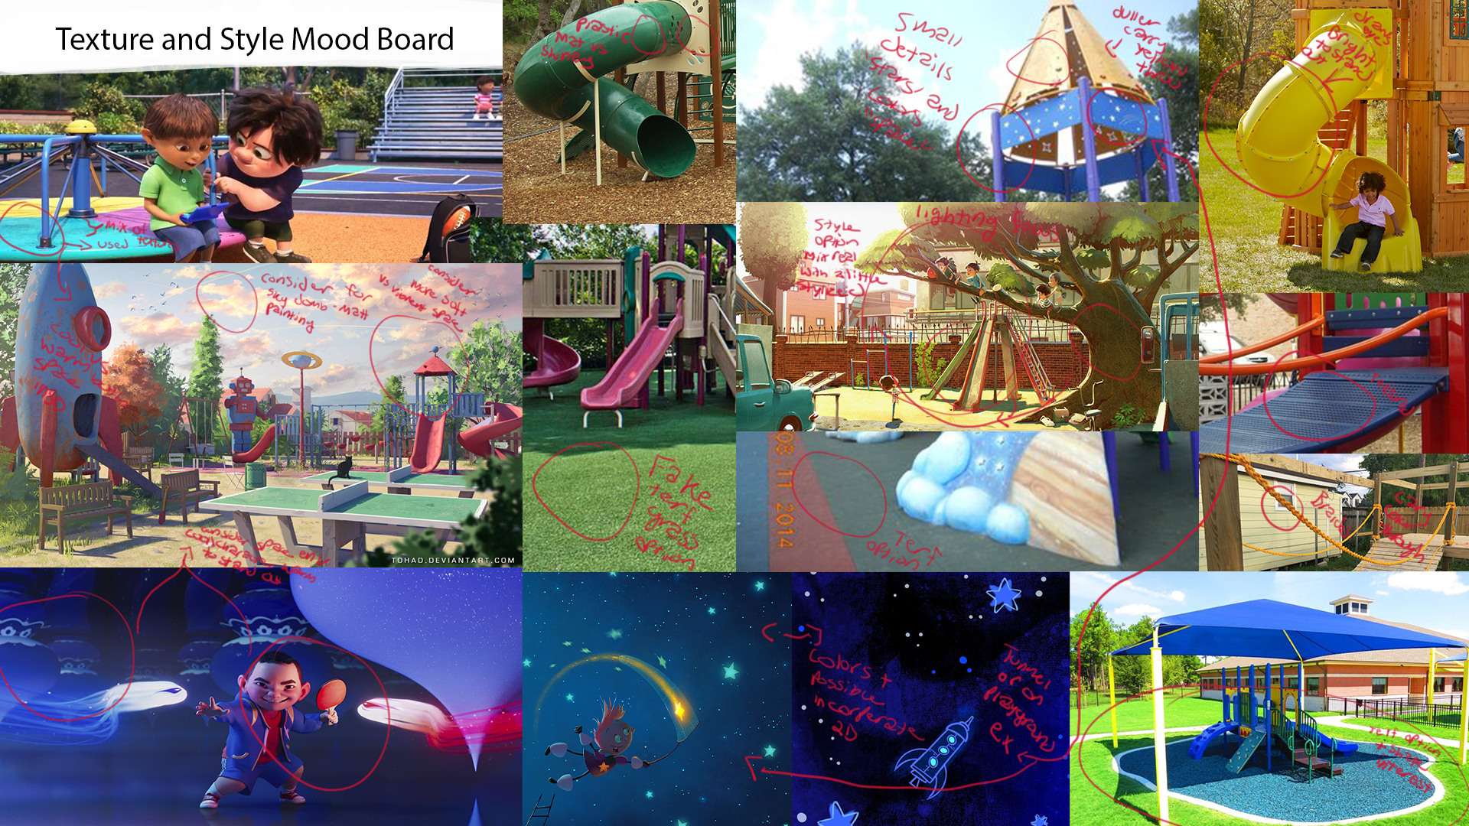
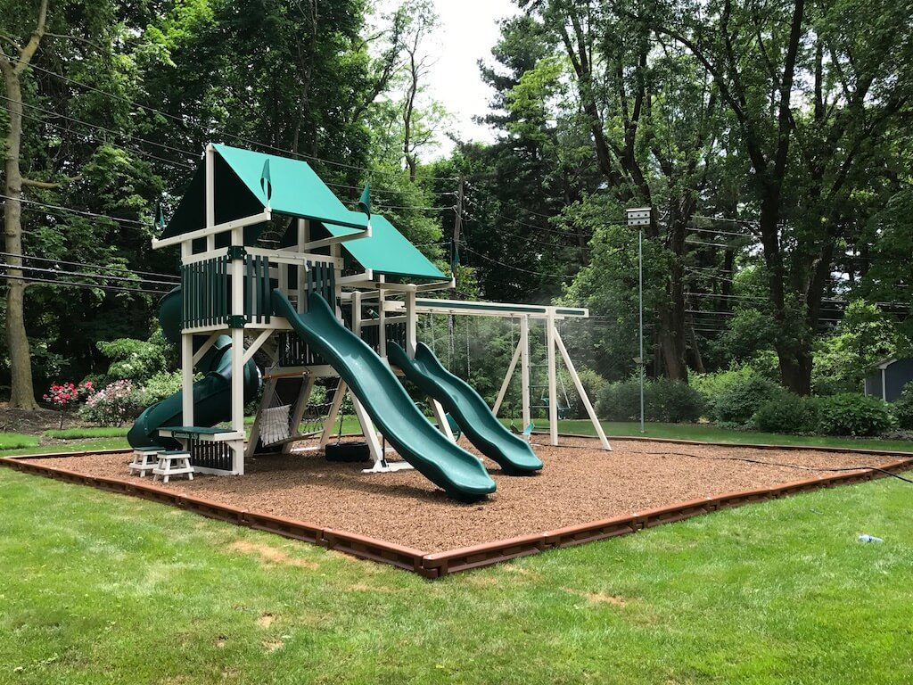
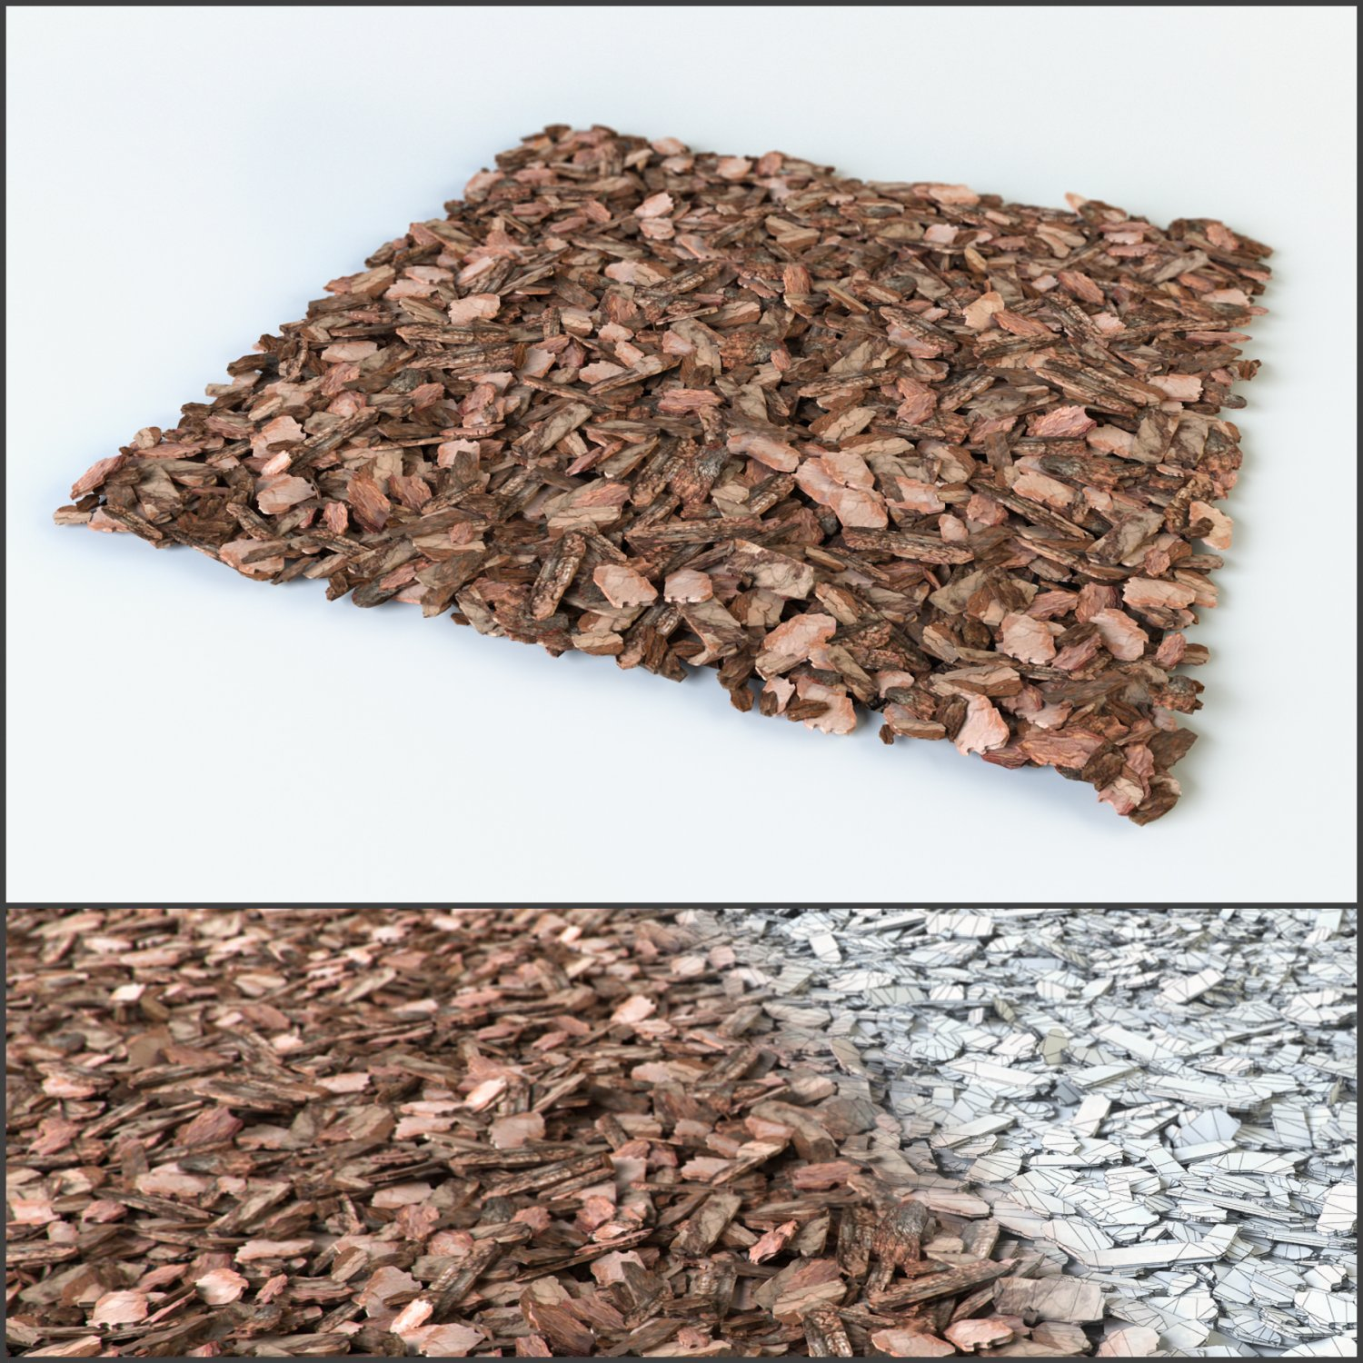
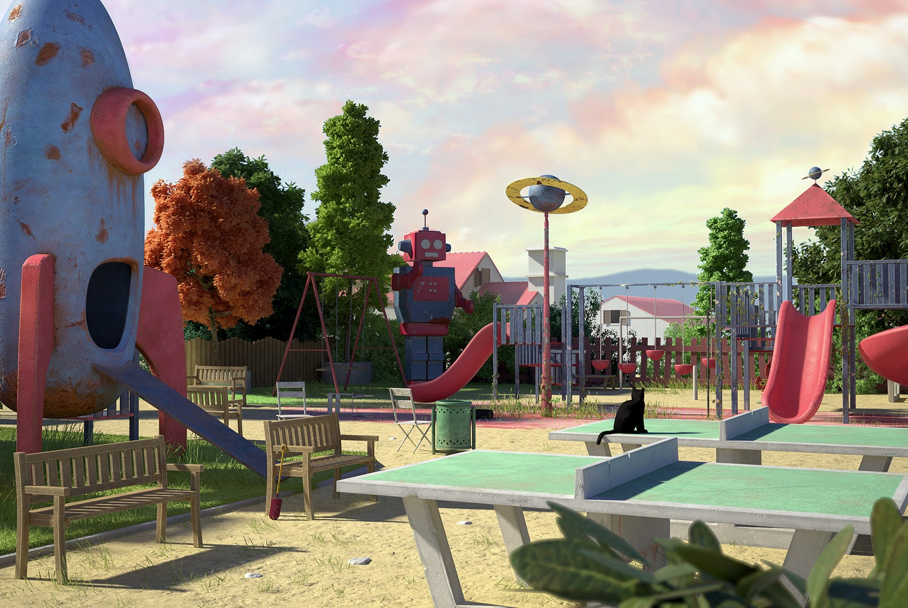
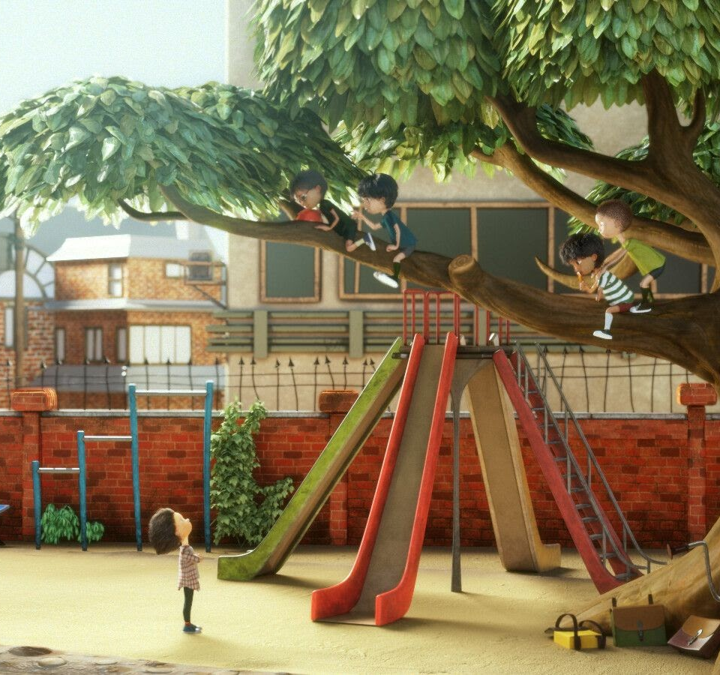
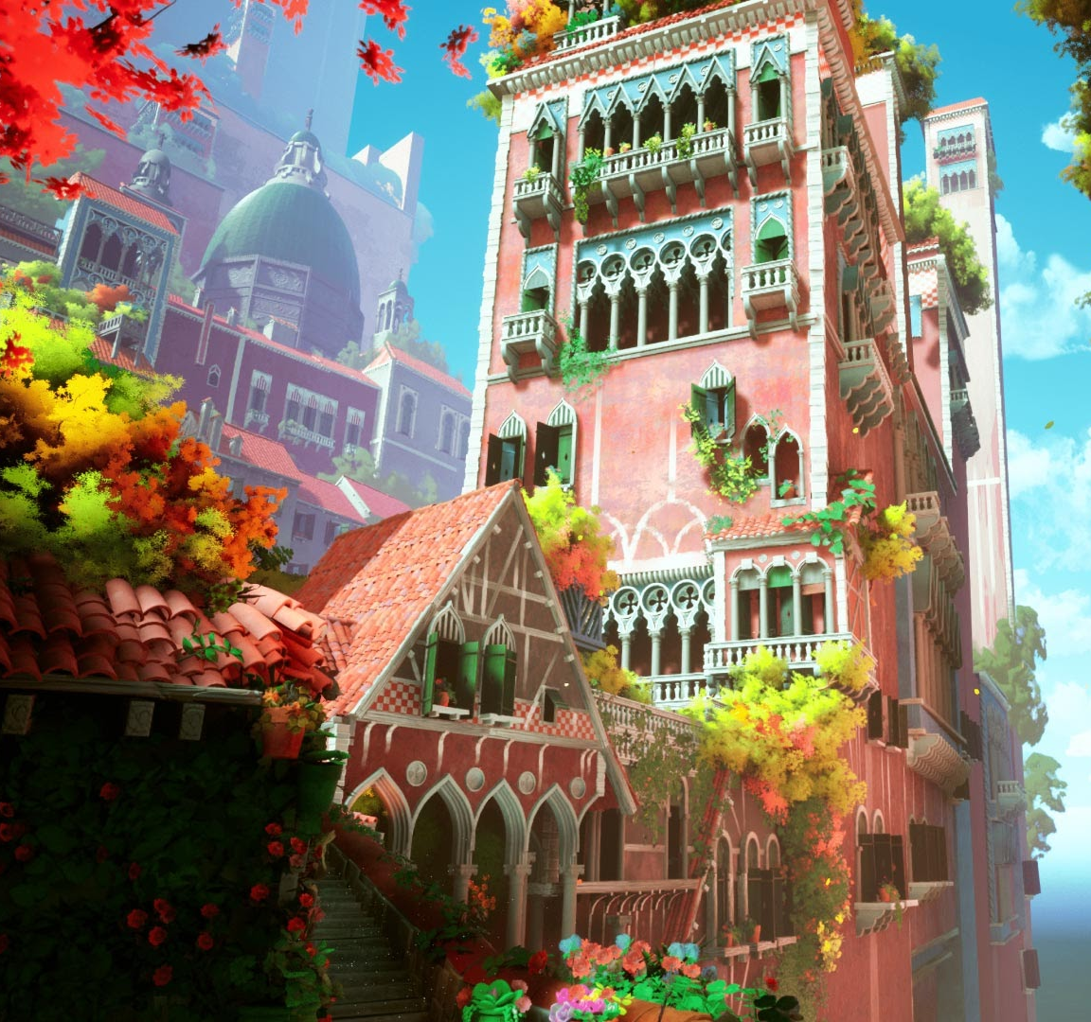
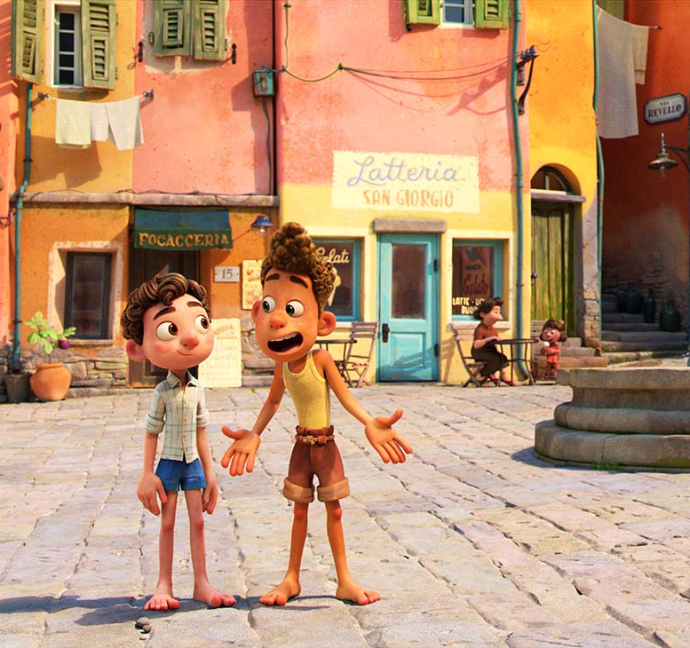
Texture
Textures - little imperfections to show a used playground
Ground texture Mulch
Sky consider using painted sky dome
Little hints that inspire her imagination of space
EX Shape engraved into playground, colors
Environment VS Character Help character stand out
( ex. Cool tones - blues vs warm – red , closer to real vs more stylized , duller vs more vibrant)
Colors and textures add variation and draws eye where needed
(Ex mix of mat and shiny plastic like a more shiny yellow slide to stand out against other mat plastic parts of the playground to draw eye to where character is)

Slide 6
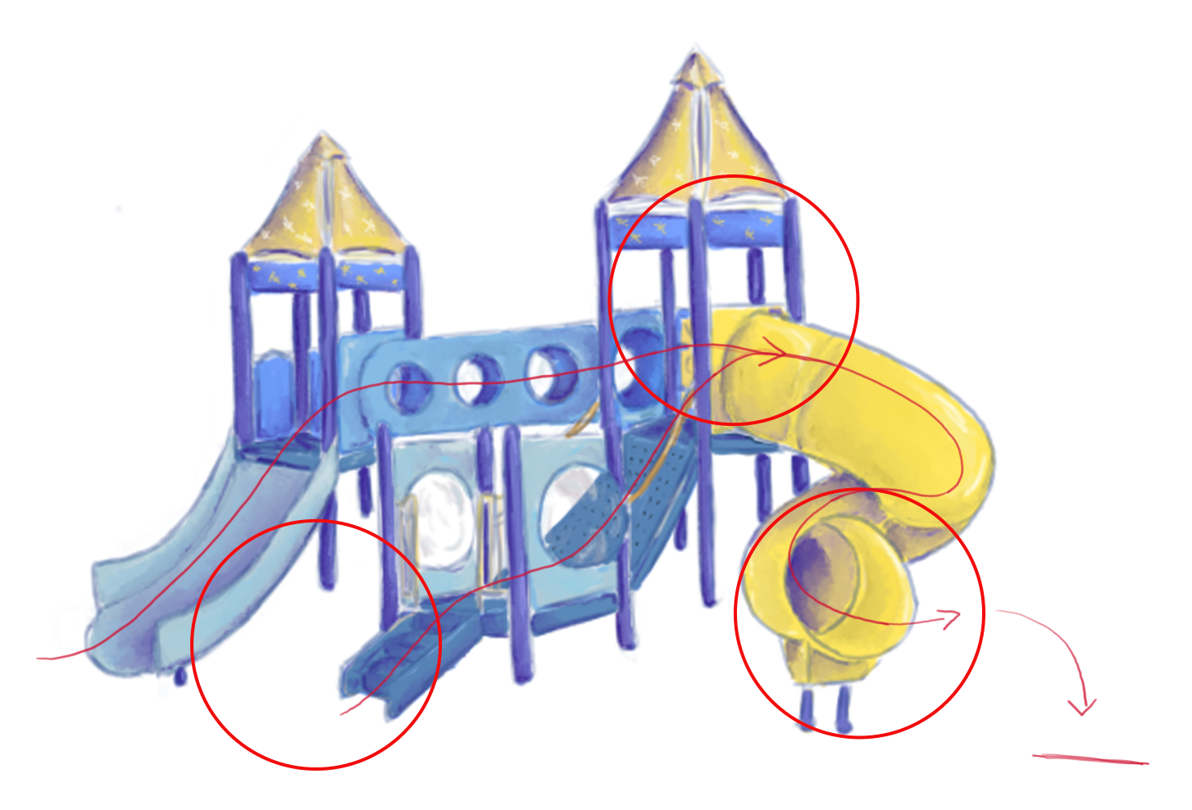
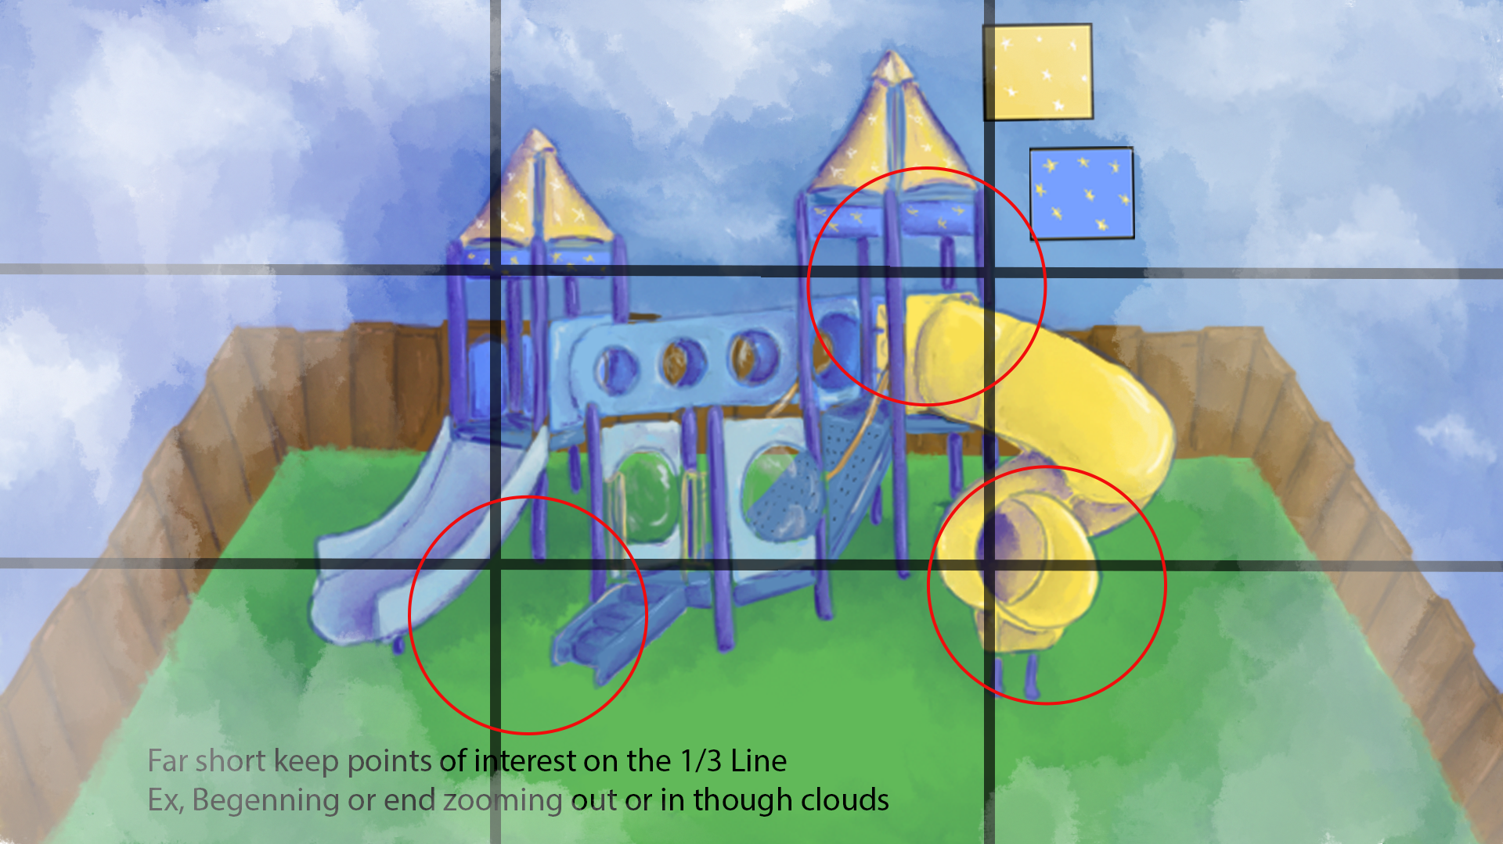
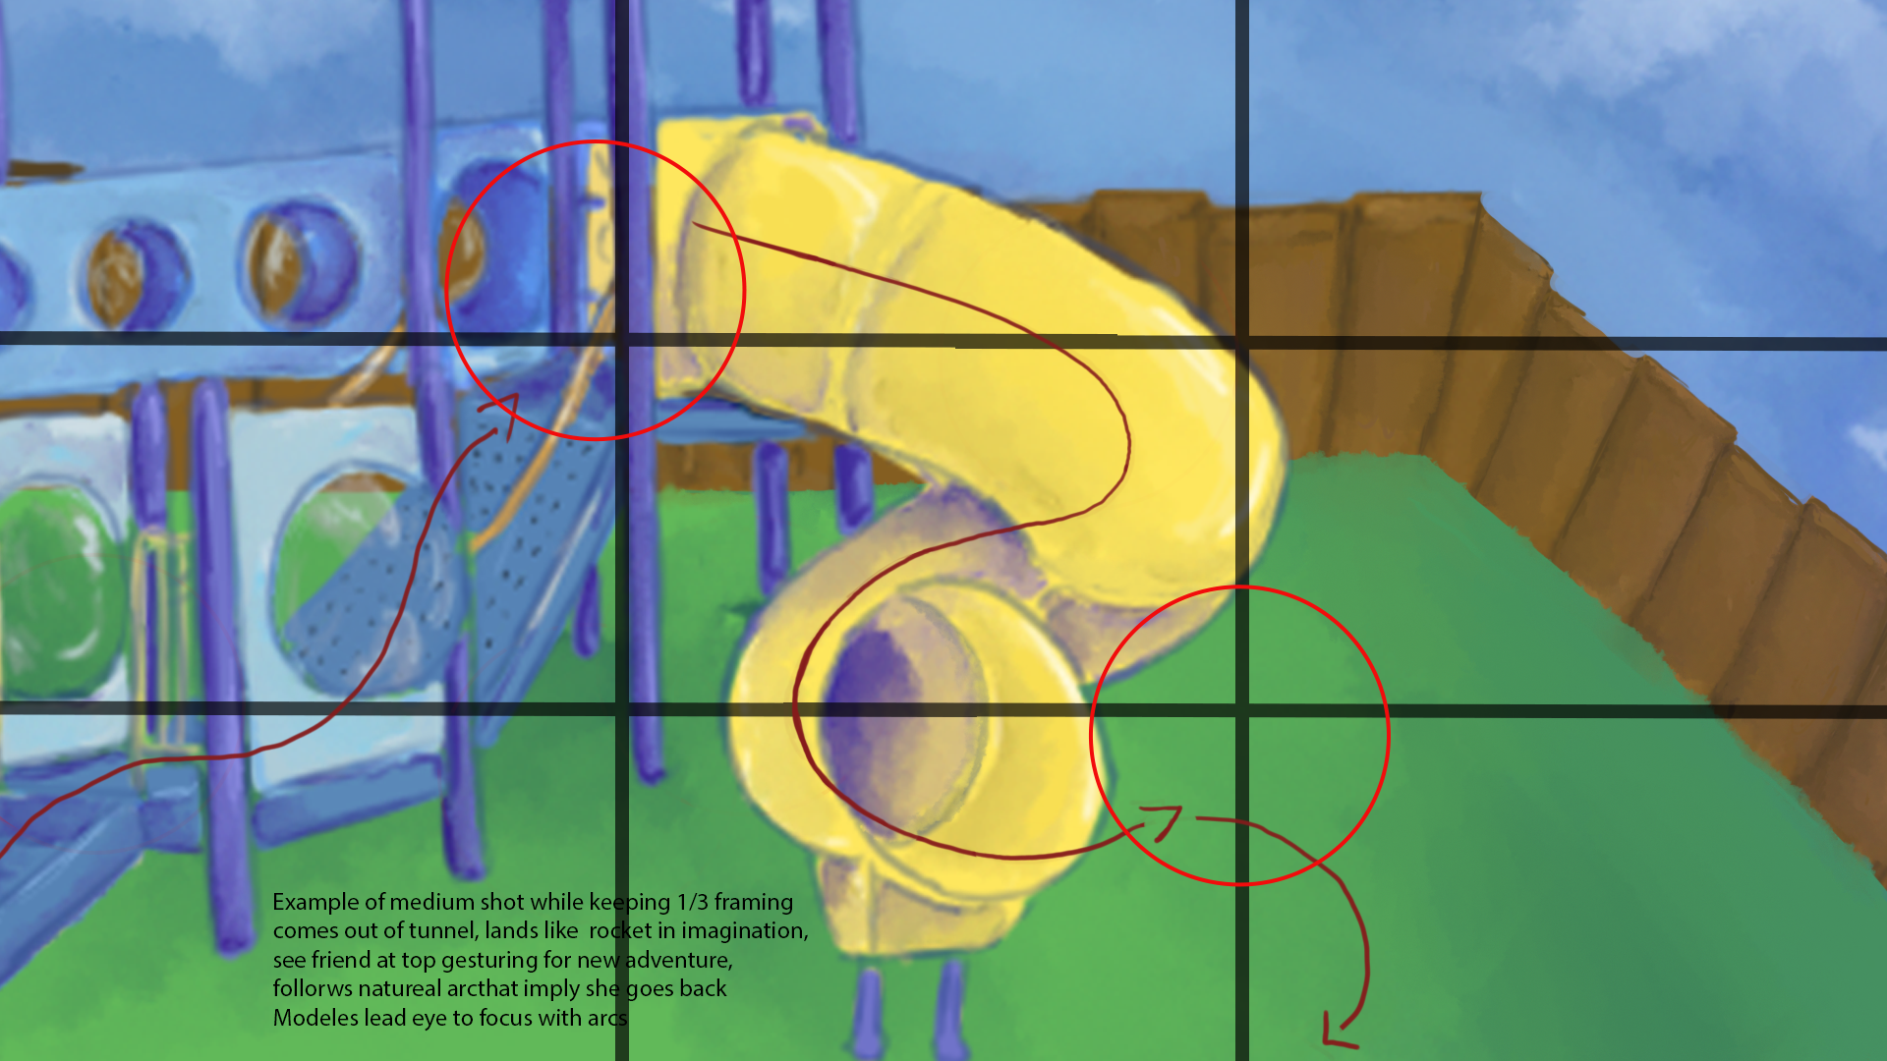
Layout with camera in mind
- Keep in mind points of interest 1/3 rule
Keep in view Arcs that lead the eye to acting
Below are examples of arcs that lead the eye though the acting space
Lighting
– Front right hits slide area to help create a clearer silhouette and view of character

